Slide 1
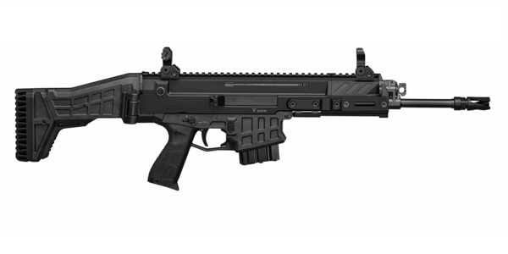




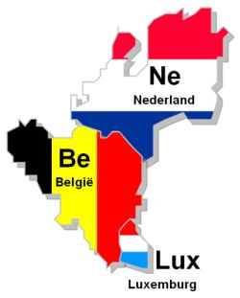
"Range Reymerswael"
Grensweg 19A 4411ST
Rilland-Bath
the Netherlands
Team M1-Belgium:-LVR
D.D: Oktober: 3/4 / 2026
Schietsportcentrum
Marc Hendrickx Wapens & Munitie
expense: €.25-;
Start 09.00u / 12.00u en 13.00u 17.00u
Match: Will be shot in the morning and Afternoen
Match Info:
-wanden en muren lopen door !
-schot in wanden en muur Dq !
-score begint tijdens schieten
-start pos as demonstrerend
Team M1-B: LVR
Team:M1-B/LVR
Area 1: Min-R 52
Area 2: Min-R 48
Area 3: Min-R 50
Totaal: Min-R 150 / Max: 730
IPSC/Targests: 40 & 60%
BNP/PARIBAS/Fortis (België) Bank accounts: 220-0425315-06
Bic code: GEBABEBB IBAN: BE85 2200 4253 1506

Slide 2

Targets 40%
Marc Hendrickx Wapens & Munitie
Team M1-B:LVR-AREA 1 : Min R = 52
Match Info:
-wanden en muren lopen door !
-schot in wanden en muur Dq !
-score begint tijdens schieten
-start pos as demonstrerend
Stage 1
Sta in de BOX
*Option 1 = Magazine inserted, first round in the chamber
All Targets 40%
St: 2
M-R-28
Stage 2
*Option 3 = complet y empty, bolt May be open,
Targets: 40 & 60%
START: Mandator: Targets L & R
Daarna Free Style ALL Targets
ST:1
M-R 24
(Option 1)
2 Schot per Target
Vanuit de BOX
Targets 40%
L
R
Mandators (L-R)
25/20/15-Meter
(Option 3)

Slide 3


Team M1-B:LVR/AREA 2 : Min R = 48
Marc Hendrickx Wapens & Munitie
Match Info:
-wanden en muren lopen door !
-schot in wanden en muur Dq !
-score begint tijdens schieten
-start pos as demonstrerend
T1
T2
T3
T4
Stage 3
*Option 1 = complet y empty, bolt May Be open,
St : 3
St:4
Stage 4
*Option 2 = Magazine inserted, chamber empty,
,bold forward hammer down
(Option 1)
(Option 2)
M-R 24
M-R 24
Mandator
T1-2 & T3-4 Van START
Meter: 15 & 25 M

Slide 4
2
3
Team M1-B: LVR/AREA 3 : Min R = 50
40%
1
40%
Marc Hendrickx Wapens & Munitie
Match Info:
-wanden en muren lopen door !
-schot in wanden en muur Dq !
-score begint tijdens schieten
-start pos as demonstrerend
Stage 5
*Option 3 = Magazine inserted, first round in the chamber
St: 5
St: 6
Stage 6
*Option 1 = Magazine inserted, first round in the chamber
Shooting BOX
Targets 40% & 60%
Mandators T:1-2-3 van START
Daarna Free Style ALL Targets
M-R 20
Targets 40%
(Option 1)
Mandators T:1-2-3 van START
(Option 1)
M-R 30

